Slide 1
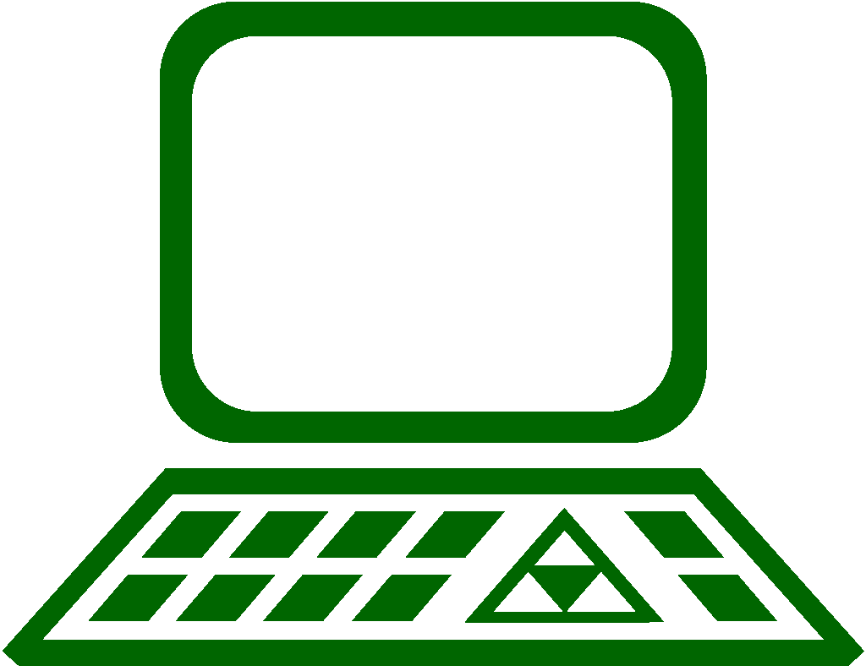
Key PC Components
Benjamin Brewster
Except where noted, content, art, and pictures are by the author

Slide 2
Why You Need to Care
Because someday you’ll have to:
Repair a PC
Plan a purchase of computer equipment that meets a specific requirement
Graphics ability, storage sizes, network interface count, USB data transfer speeds, CPU computation speed (serial and/or parallel), etc.
Compare form factors and standards to make decisions
Understand new technology as the market (rapidly) changes

Slide 3
Computer Hardware Overview
All computers consist of the following major components:
Enclosure/case
Motherboard (MOBO or board)
Central Processing Unit (CPU)
Random Access Memory (RAM)
Power Supply Unit (PSU)
Input/Output methods such as a mounted drive
Our goal isn’t to talk about the theoretical workings of these components (that’s for other classes), but to talk about usage, selection criteria, identification, and other practical considerations

Slide 4
Personal Computer (PC) Hardware Overview
All general purpose Personal Computers consist of some or all of the following major components:
Enclosure, Case, or Frame
Motherboard (MOBO or board)
Central Processing Unit (CPU)
Random Access Memory (RAM)
Power Supply Unit (PSU)
Drives (HDD, SSD, Optical)
Cooling systems (CPU and case)
Graphics Processing Unit (GPU)
Network Interface Controller (NIC)
Peripherals (input devices, speakers, monitors, etc.)

Slide 5
PC Standards: AT and ATX
AT comes from the name of IBM’s second-generation PC, the IBM PC/AT, where AT stands for “Advanced Technology”
The ATX standard is the extended, modern version of the AT standard
ATX specifies:
Motherboard size (many form factors: Standard ATX, Micro-ATX, Mini-ITX, etc.)
Manufacturer-defined connector block on back of system
Power supply voltages: +12V, +5V, +3.3V, and low-power -12V, +5V_{SB}
PSU dimensions
Power connector: 24-pin + 4-pin
Power switch: PSU controlled by OS and front-panel switch
Let’s look at our MOBO for this class’s Labs!

Slide 6
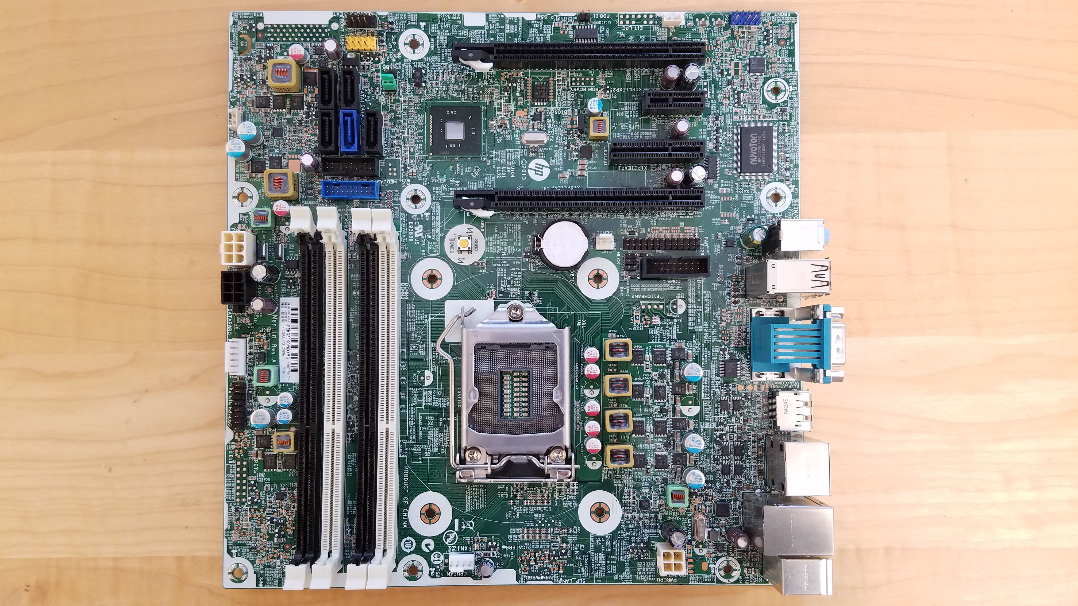
Typical Motherboard Components
HP Z230 Motherboard

Slide 7
Motherboard Specifications
Modern PC hardware is developed to match a set of motherboard specifications
Old, de facto specification: AT
De facto because other clones simply copied the form factor of the IBM AT
Current specification: ATX
Newer but un-loved spec: BTX

Slide 8
Motherboard Busses
An internal computer bus (short for omnibus) connects all the computer components together, providing a way for data to get to and from the CPU, RAM, and I/O devices
The connection between CPU and RAM is tightly coupled, and runs independently from other components
An external bus connects peripherals to the computer. Today, this is typically accomplished with USB

Slide 9
Motherboard Busses
Old-school parallel busses reached their limit in terms of speed because of the difficulties of crosstalk, timing skew, EMI, and power consumption
Serial busses don’t have those problems, and have been able to achieve much faster speeds, which is a bit counter-intuitive
Intel CPUs, for example, use a specific chipset on the MOBO that includes the physical, electrical, and logical connections for the busses
E.g., Intel’s Coffee Lake-series CPUs use the Z370 chipset

Slide 10
Typical Motherboard Components
HP Z230 Motherboard
Let’s identify some parts together…
RAM Slots
CPU socket
CPU hold-down

Slide 11
Typical Motherboard Components
HP Z230 Motherboard
Non-standard MOBO power
CPU power

Slide 12
Typical Motherboard Components
HP Z230 Motherboard
PCI Express slots
Battery (powers clock)
I/O ports on next slide

Slide 13
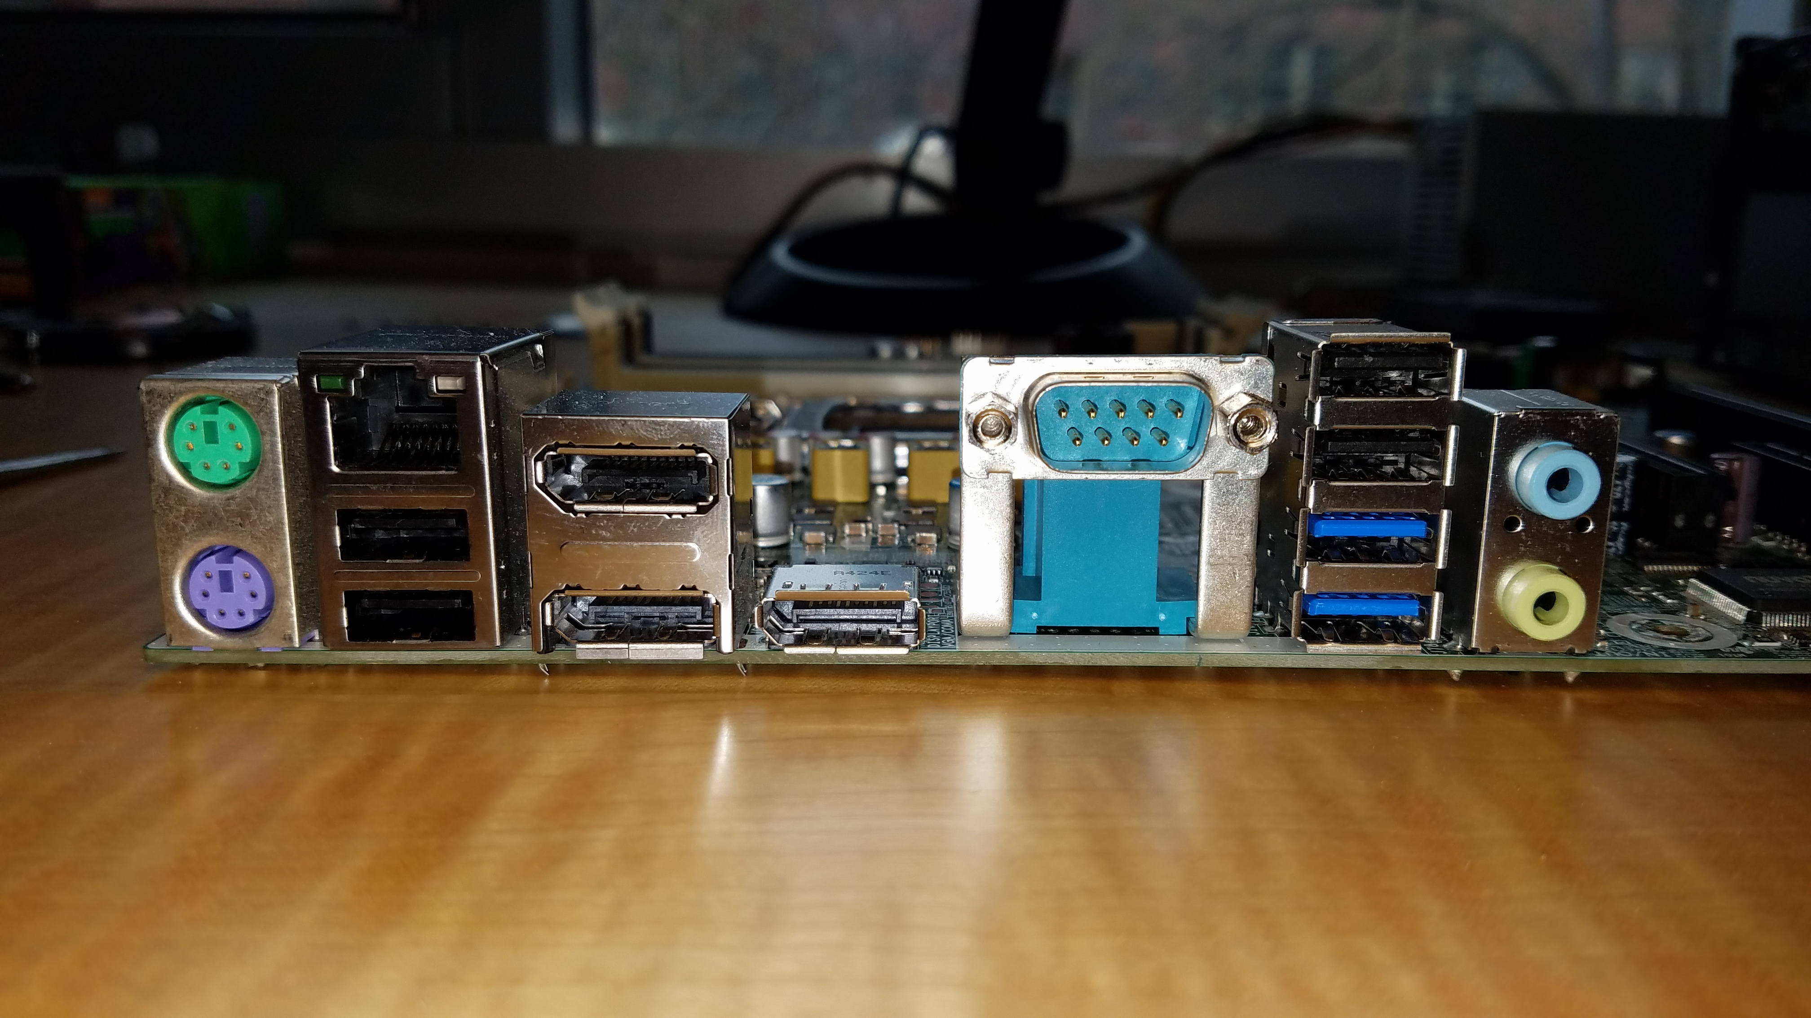
HP Z230 Motherboard
Network, 8P8C connector
4x USB 2 2x USB 3
PS/2 mouse (top), keyboard
3.5mm analog Audio line-in (top), line-out
DisplayPort
RS-232 aka Serial

Slide 14
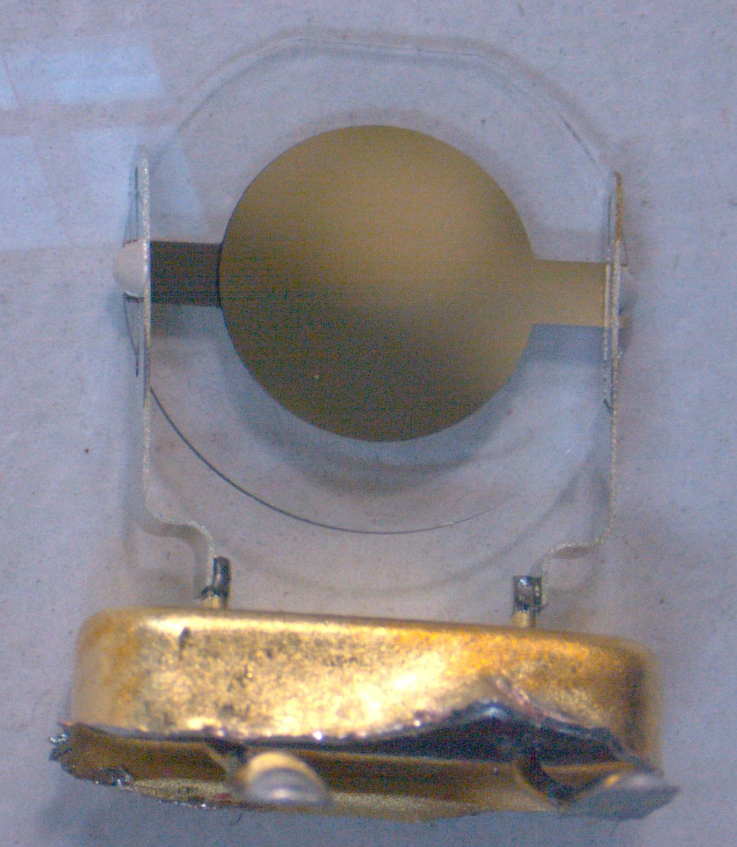
Typical Motherboard Components
HP Z230 Motherboard
Primary oscillator
SATA Ports
Looks similar to this:
By Altzone at English Wikipedia [Public domain], via Wikimedia Commons
Case USB block headers
Header for front panel lights and switches

Slide 15
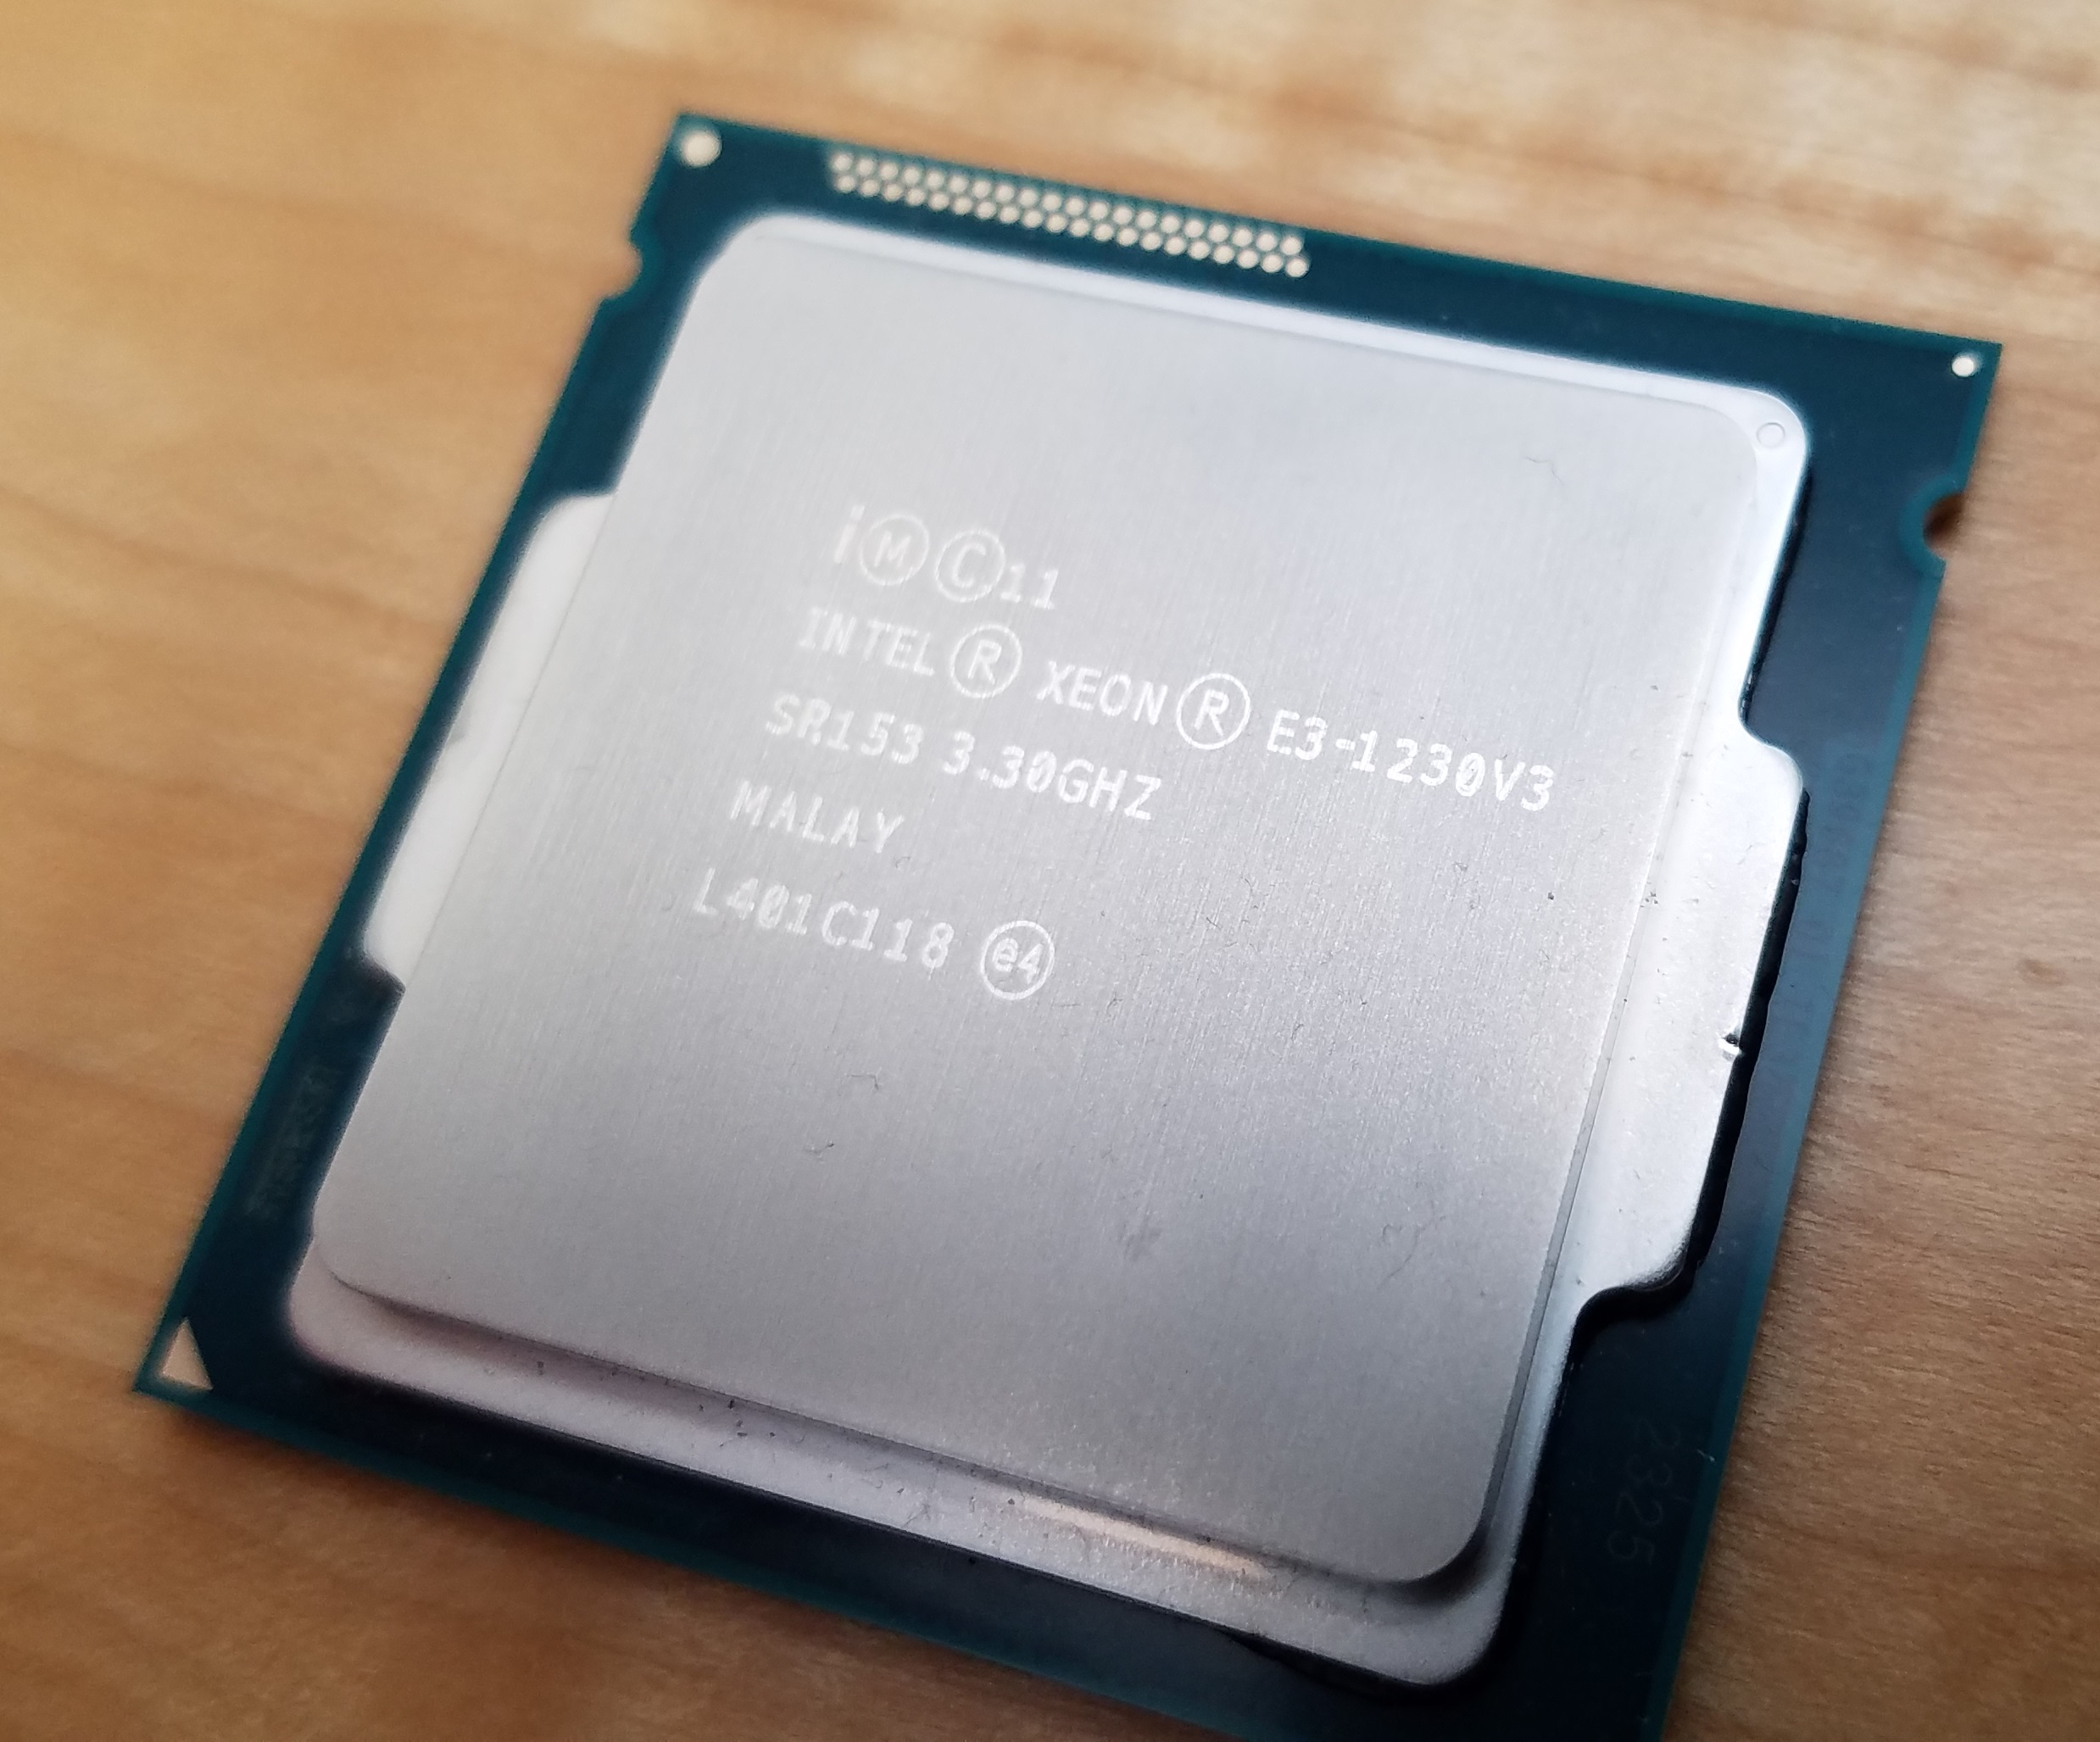
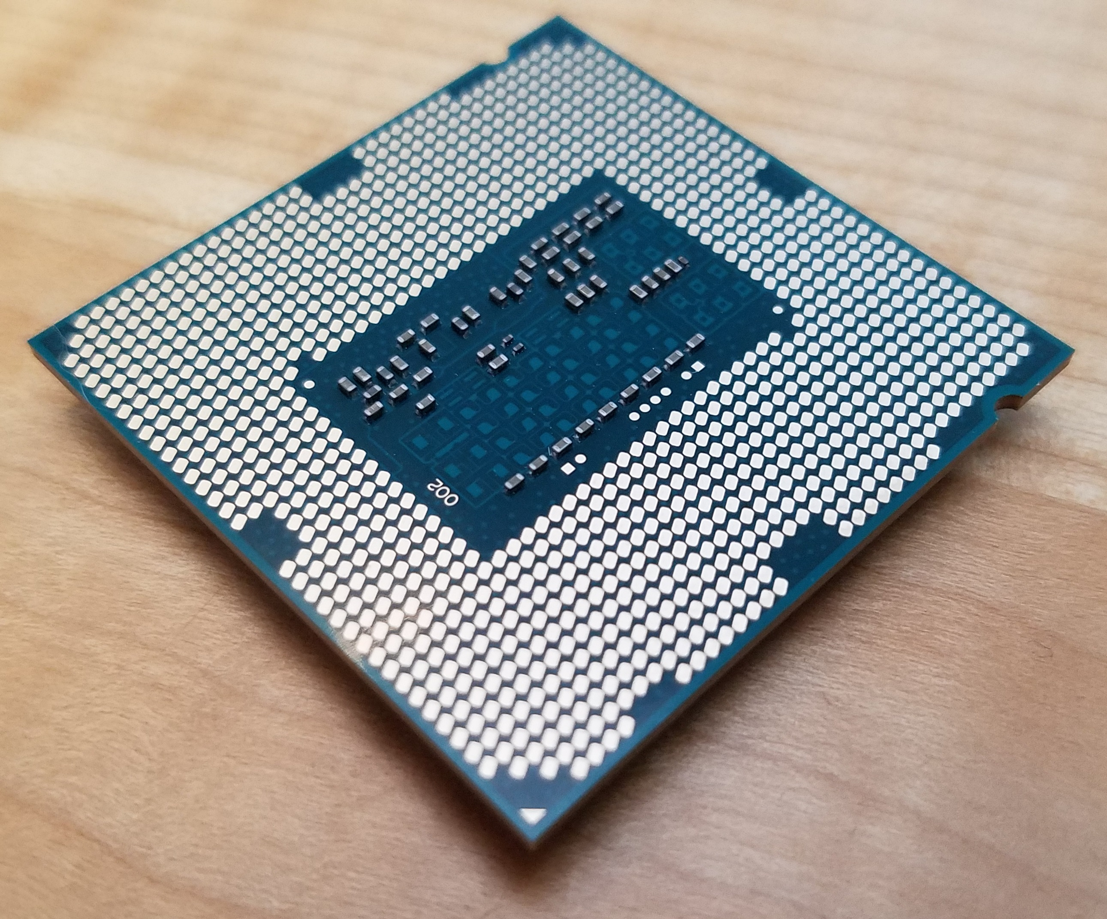
CPU
The Central Processing Unit handles most of the processing of program instructions done in the computer
Other processing units in a computer include:
Motherboard chipset, which handles basic input and output
Graphics Processing Unit (GPU), which is nearly a mini-computer all by itself
From the perspective of a sysadmin, you’ll select CPUs based on the proper intersection of price and features for a specific use

Slide 16
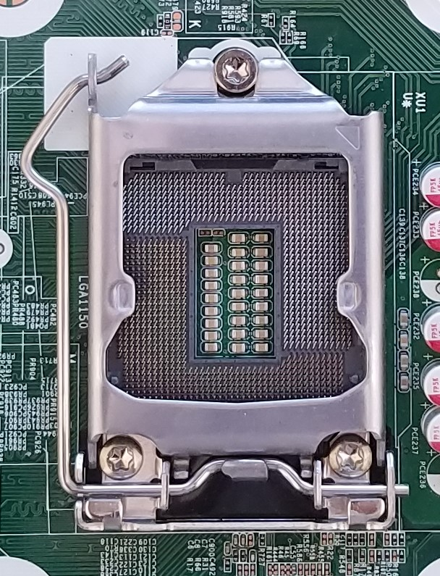
CPU Sockets
The CPU socket on a motherboard only supports a certain class of CPUs.
This HP Z230 socket is for LGA1150 CPUs only.
LGA stands for Land Grid Array, and refers to the fact that the pins are on the socket, while the CPU remains flat
1150 refers to the 1150 pins/pads
CPU features and specs dictate the shape of sockets

Slide 17
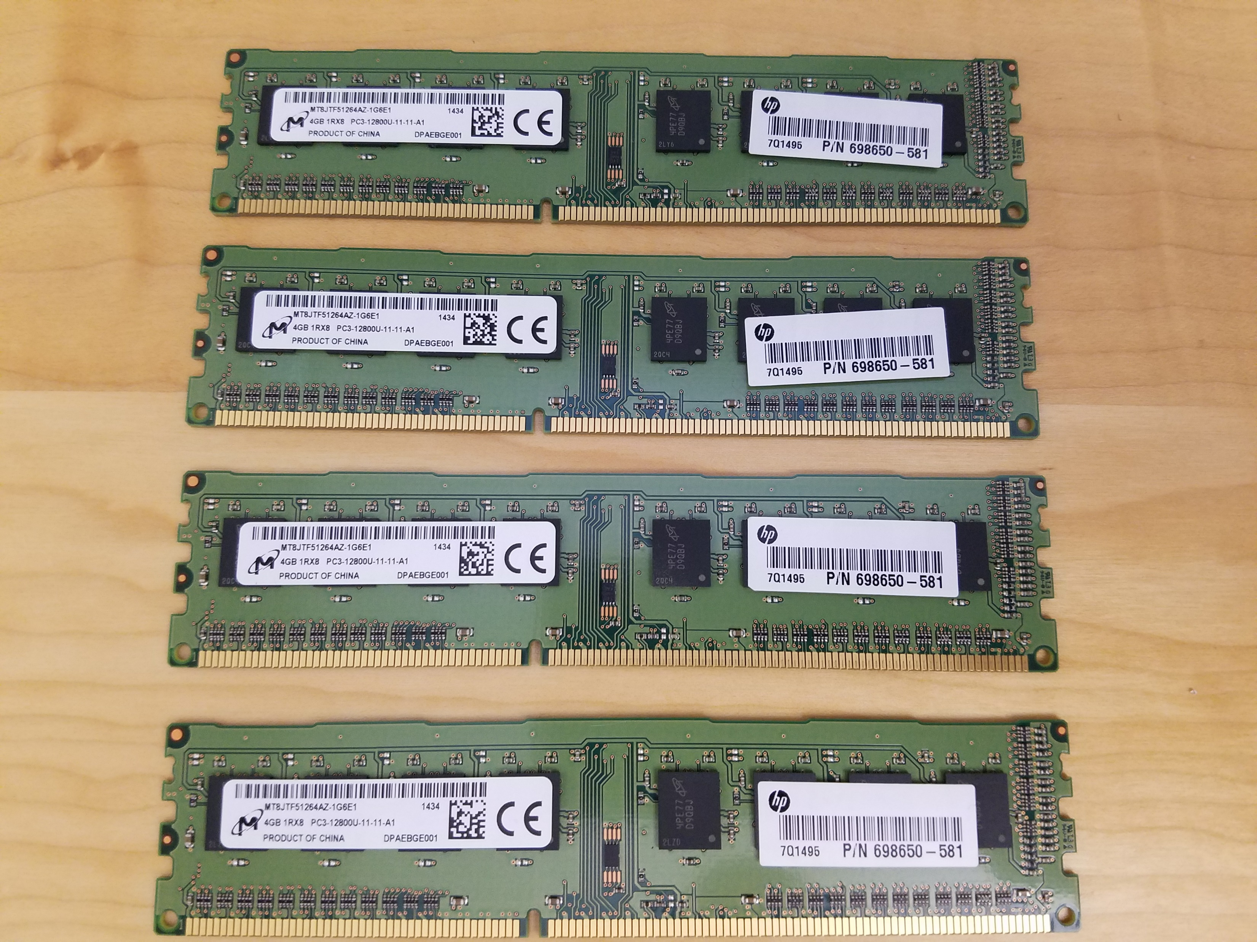
RAM
Random Access Memory modules come in lots of speeds, sizes, shapes, and technologies, some with heatsinks, some read two at a time (dual channel)
This is the 4GB OEM module in our HP Z230 PC. It’s type is PC3-12800U, which uses DDR3-1600 DRAM chips in an unbuffered (faster, but perhaps less reliable) configuration running at 12.8 GHz total across the entire module

Slide 18
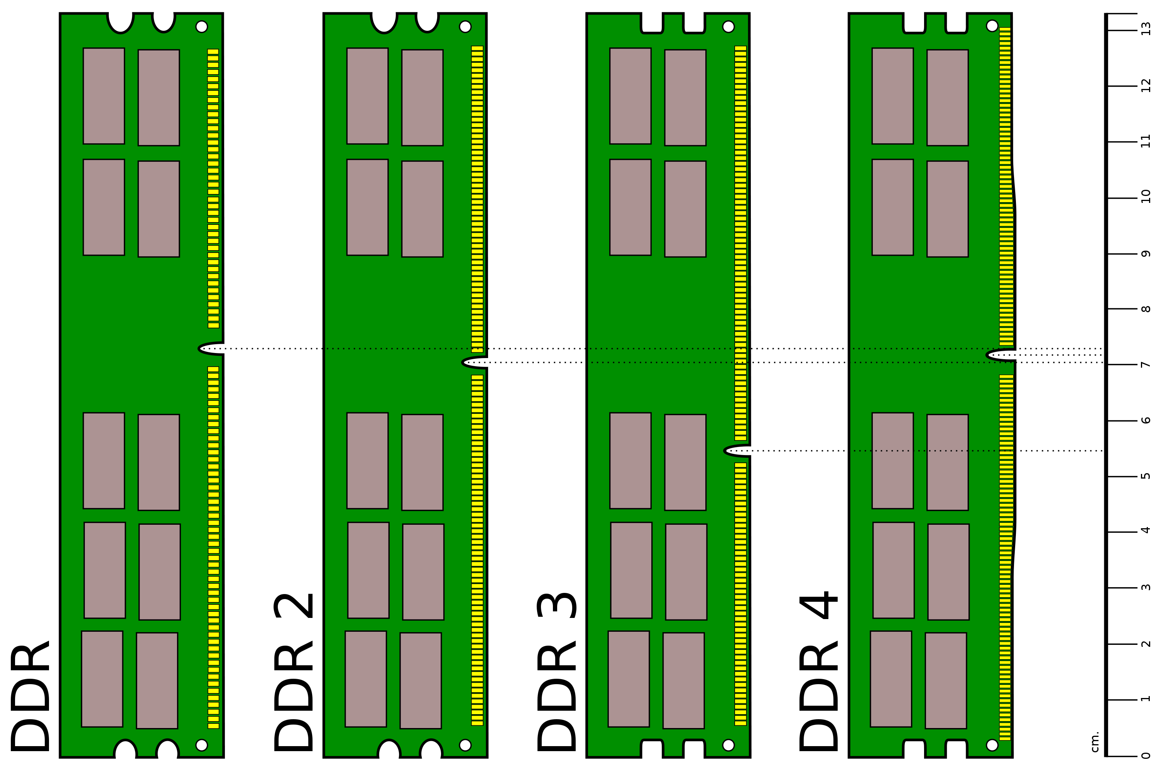
RAM - DDR
Differentiate generations by notch (aka key) position
Double Data Rate RAM differs from Single Data Rate RAM in that it transfers data on both the rising and falling edges of the oscillator-generated clock signal
By Martini - Own work, Public Domain, https://commons.wikimedia.org/w/index.php?curid=8941276

Slide 19
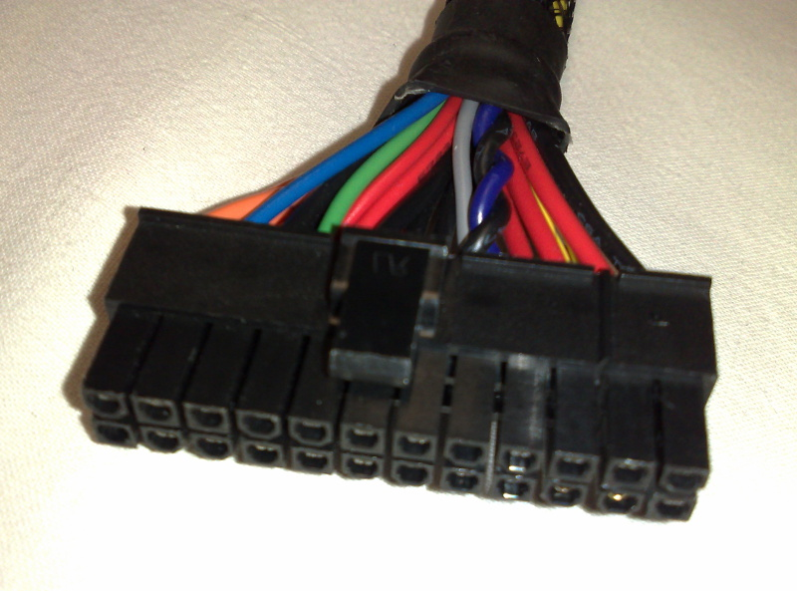
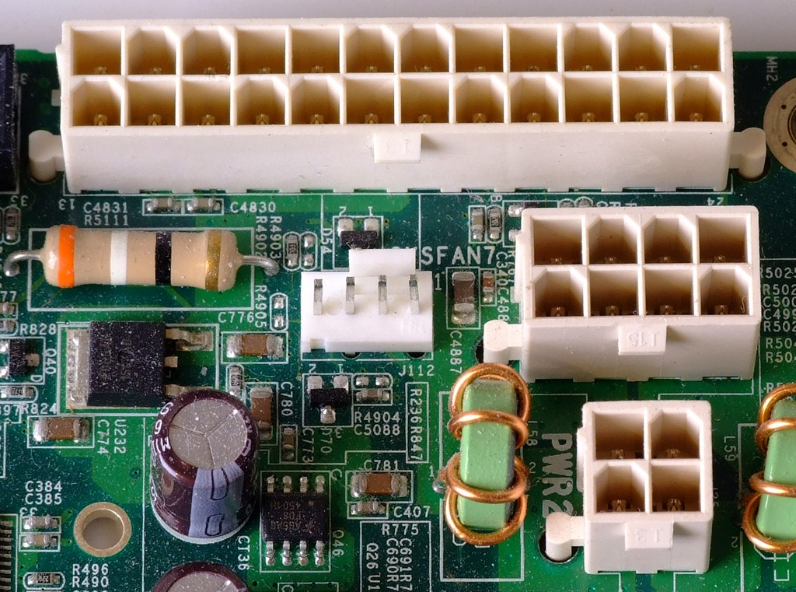
Power
Power Supply Units provide several DC voltages for the components of a computer, adapting it from main supply (120V AC)
ATX specifies:
Voltages: +12V, +5V, +3.3V, and low-power -12V, +5V_{SB}
PSU dimensions
Primary 24-pin MOBO connector
Power switch: PSU controlled by OS and front-panel switch
By Dsimic at English Wikipedia, CC BY-SA 3.0
By Tobias Maier (Own work) [CC0], via Wikimedia Commons

Slide 20
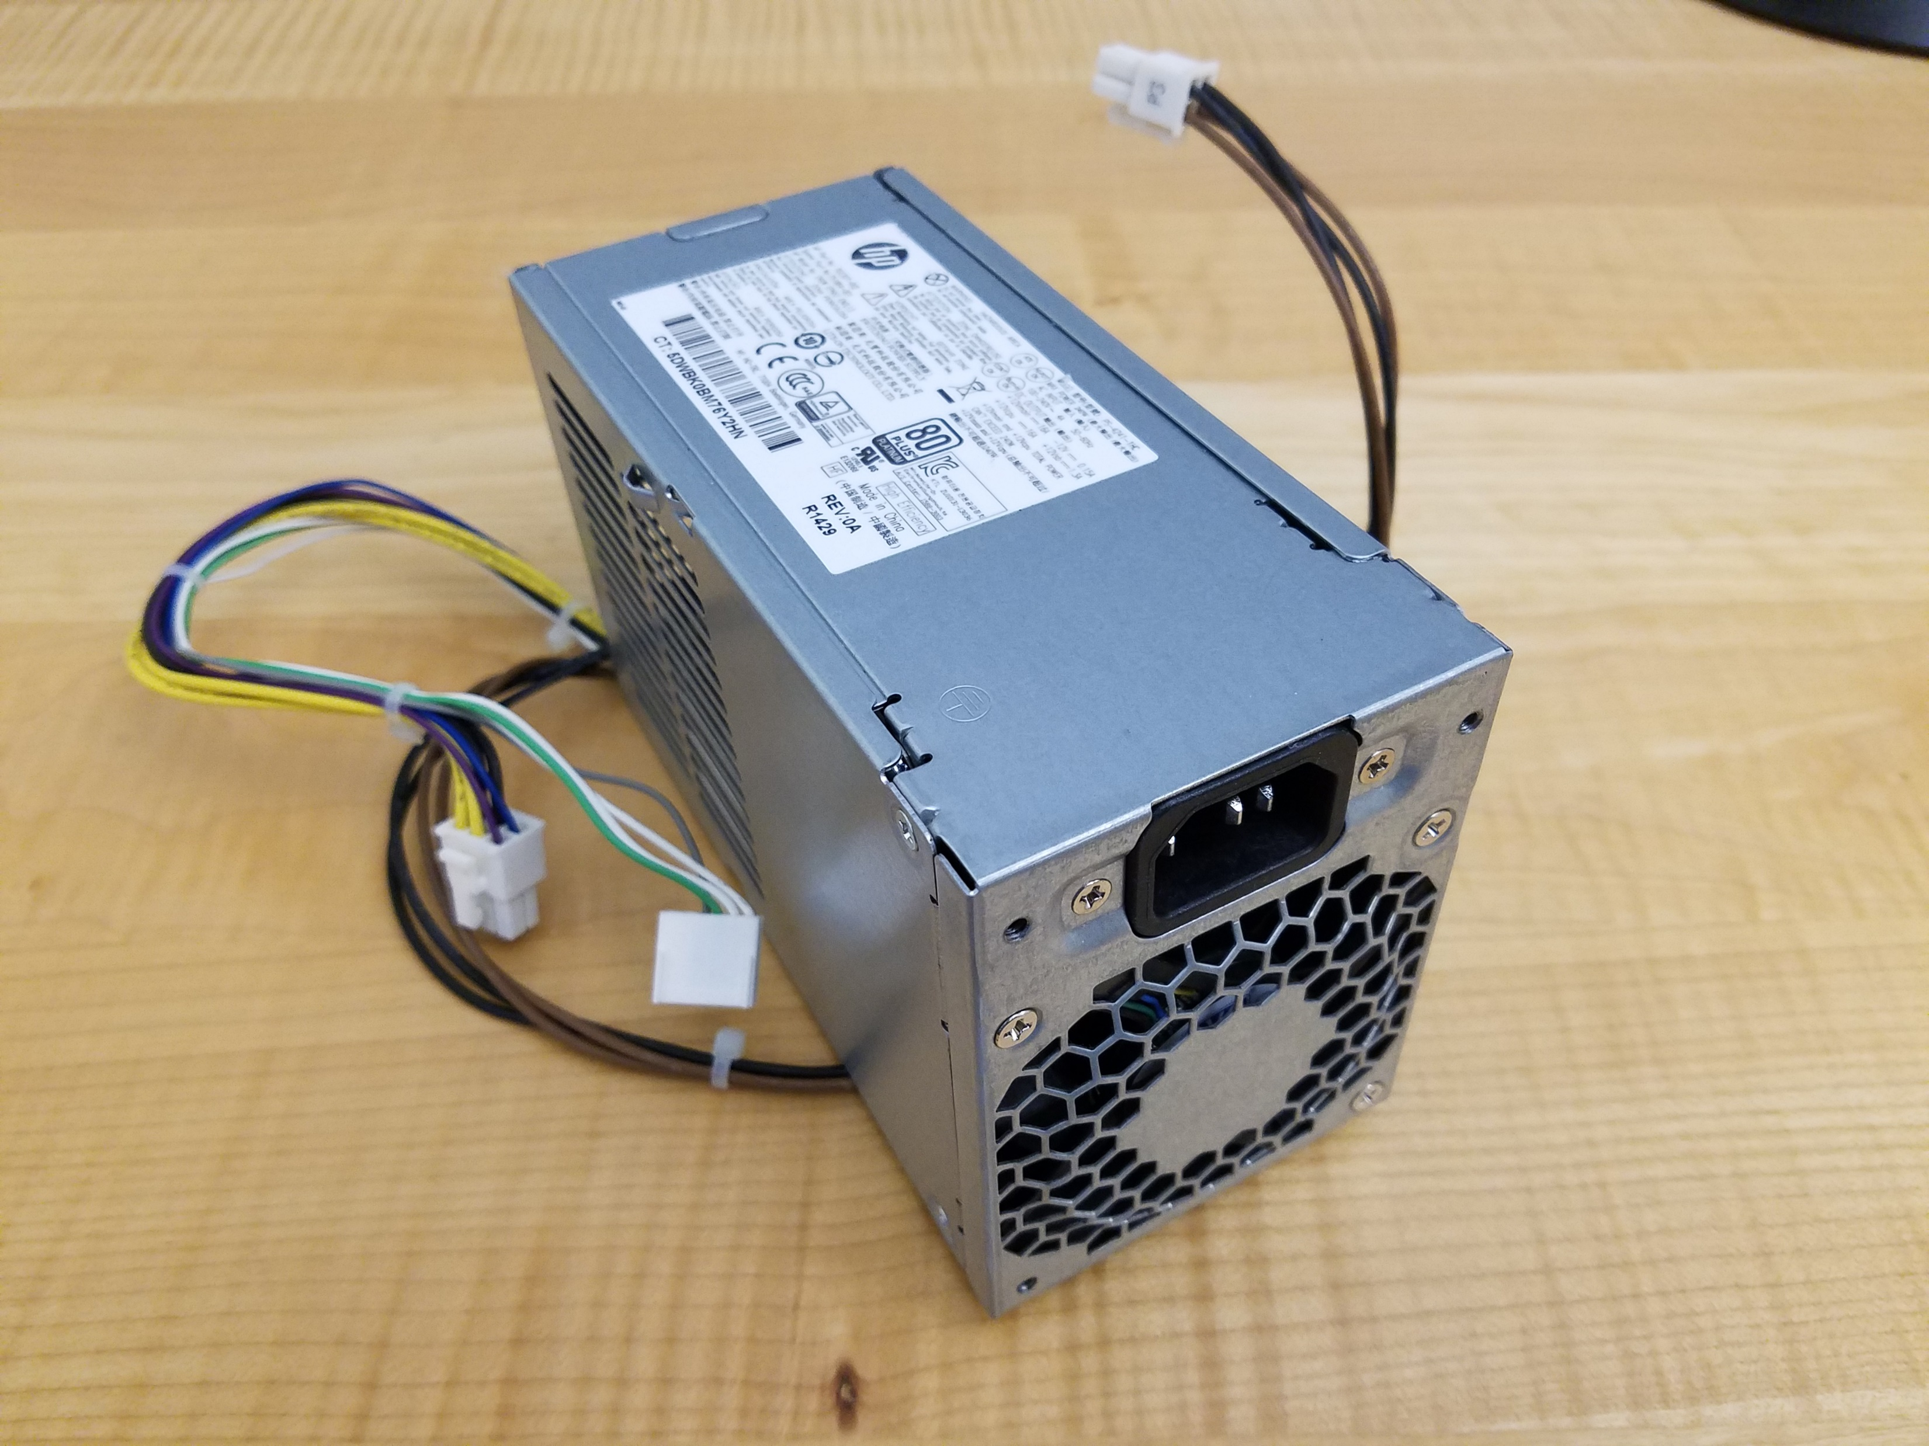
Power
This is a non-standard form factor PSU for the HPZ230:

Slide 21
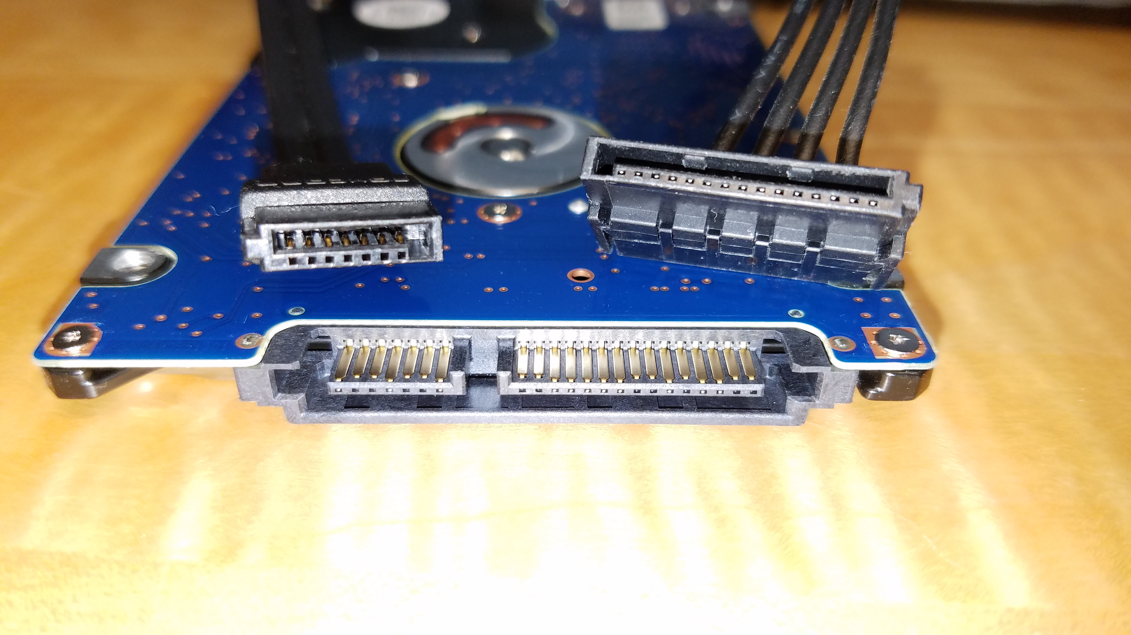
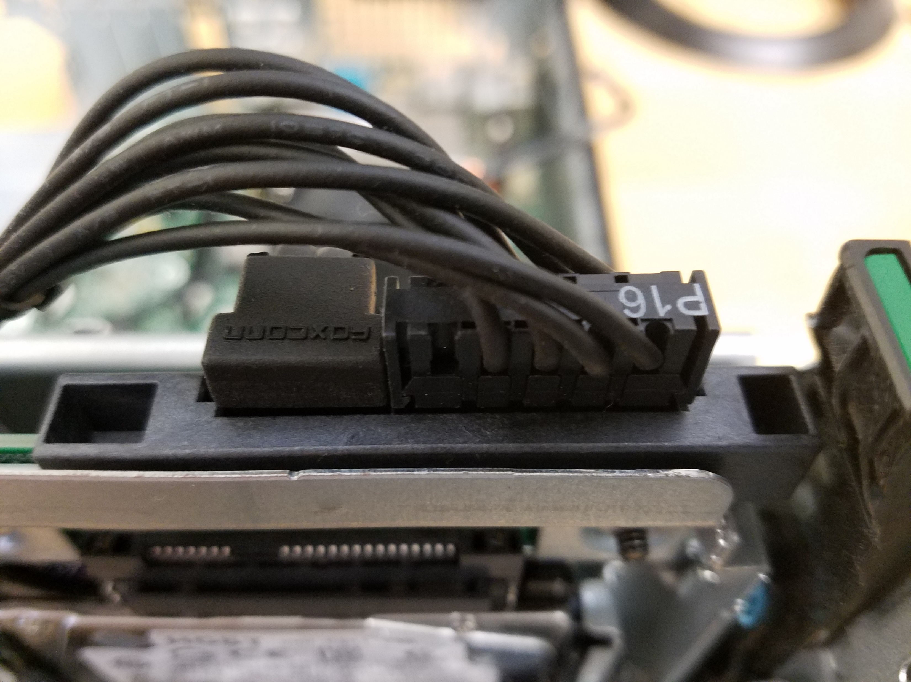
Interfaces - SATA
SATA stands for “Serial AT Attachment”
Replace the ol’ ribbon cable Parallel ATA standard
Consists of both data cable and power cable standards

Slide 22
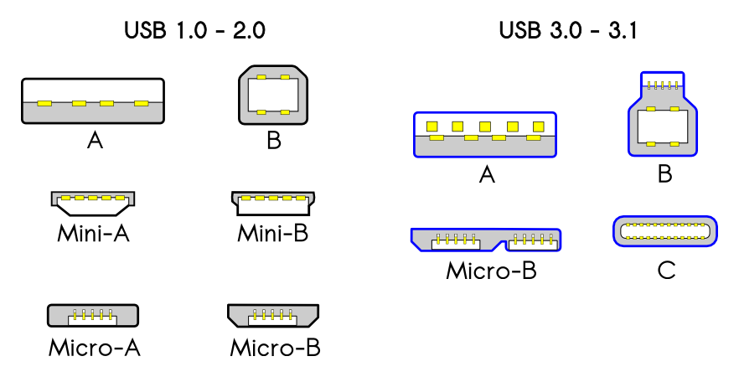
Interfaces - USB
Universal Serial Bus is the prevalent peripheral bus used today
There are lots of different plugs:
By Milos634 - Own work, CC BY-SA 4.0, https://commons.wikimedia.org/w/index.php?curid=42694553

Slide 23
Interfaces - USB
USB connections are directed, such that one host device is all the way upstream, while other devices connect in a tree graph
Power is provided via USB and can only flow downstream: peripherals cannot power the host or upstream devices
Powered Hubs can often provide more power than the host can
PC
FLASH DRIVE
CAMERA
HUB
MOUSE
SPEAKERS

Slide 24
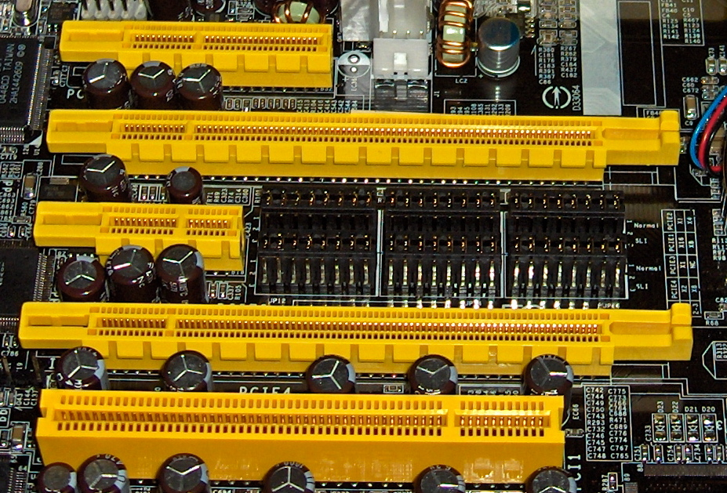
Interfaces - PCI
PCIe x1
PCIe x4
PCIe x16 Lane Slots
ISA gave way to PCI, which has given way to PCI Express (PCIe)
PCIe is a serial computer expansion bus standard used in all modern PCs to connect devices requiring high speed data transfer
Some flash-based hard drives
Video cards
High-speed network adaptors (10Gb)
Organized as a serial hierarchical network like USB(!)
By w:user:snickerdo - come from en.wikipedia, CC BY-SA 3.0, https://commons.wikimedia.org/w/index.php?curid=923562
PCI

Slide 25
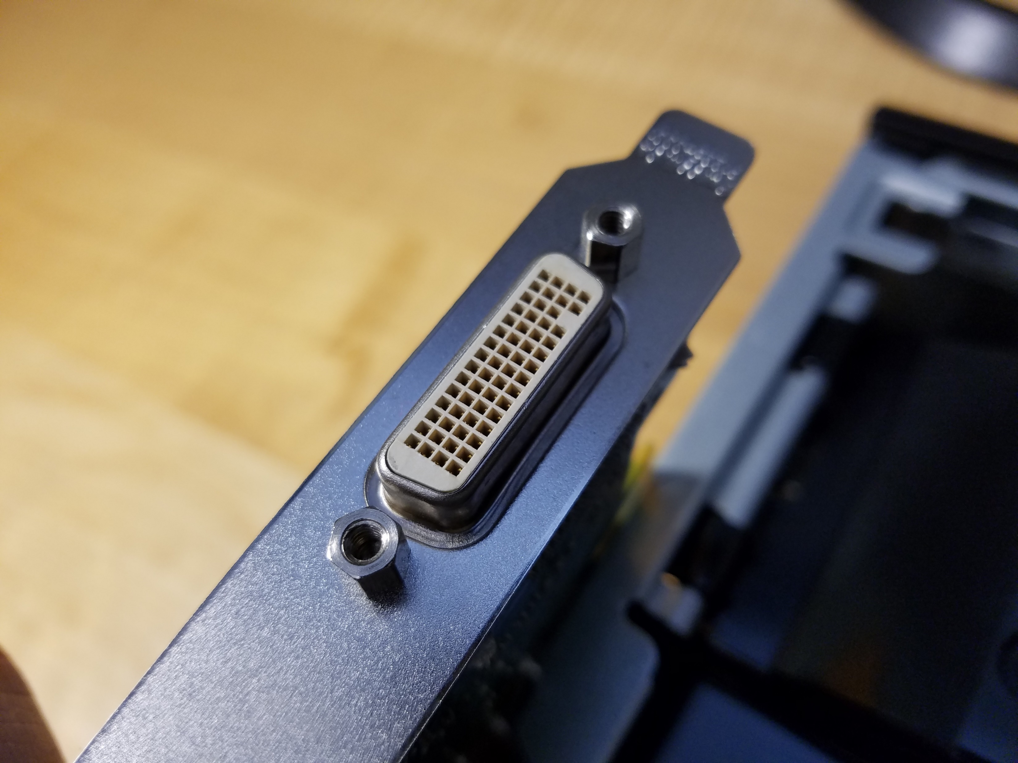
Interfaces - Video
Video interface connectors change frequently! The current common jacks are HDMI, DVI, and VGA
Ubiquitous digital HDMI supports up to 10240 x 4320 @ 120Hz, while DVI supports up to 2560 × 1600 @ 60Hz
Old-school analog VGA supports up to 2048 × 1536 @ 85Hz
Our HP Z230 uses a connector called DMS-59, which uses an adapter cable to split off and provide two DVI-I interface jacks at once

Slide 26
Cooling Systems
Computer components must have a way to dispose of waste heat, or they will burn up
Active cooling fans pull air across the fins of heatsinks attached directly to hot components such as the CPU, PSU, GPU, drives, and MOBO chipset
Heat may also be transferred via heatpipes, liquid cooling, and even submersion

Slide 27
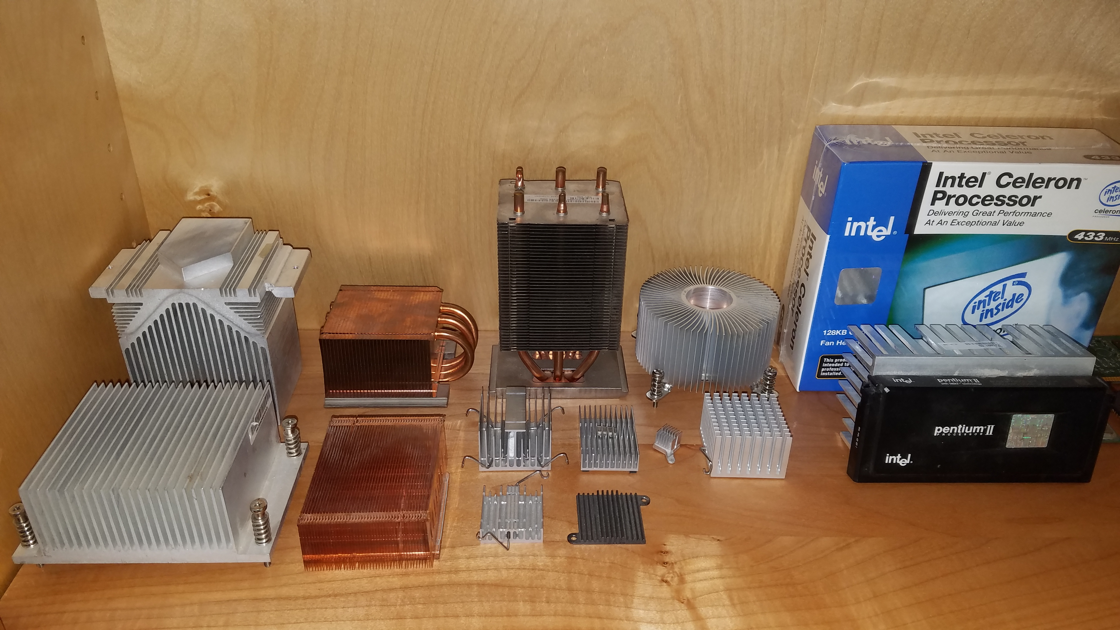
HEATSINKS

Slide 28
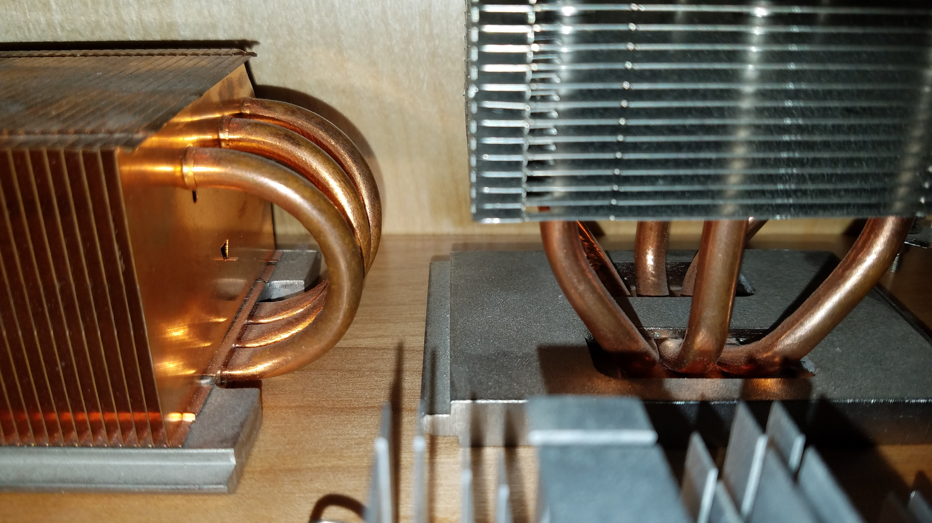
HEATSINKS

Slide 29
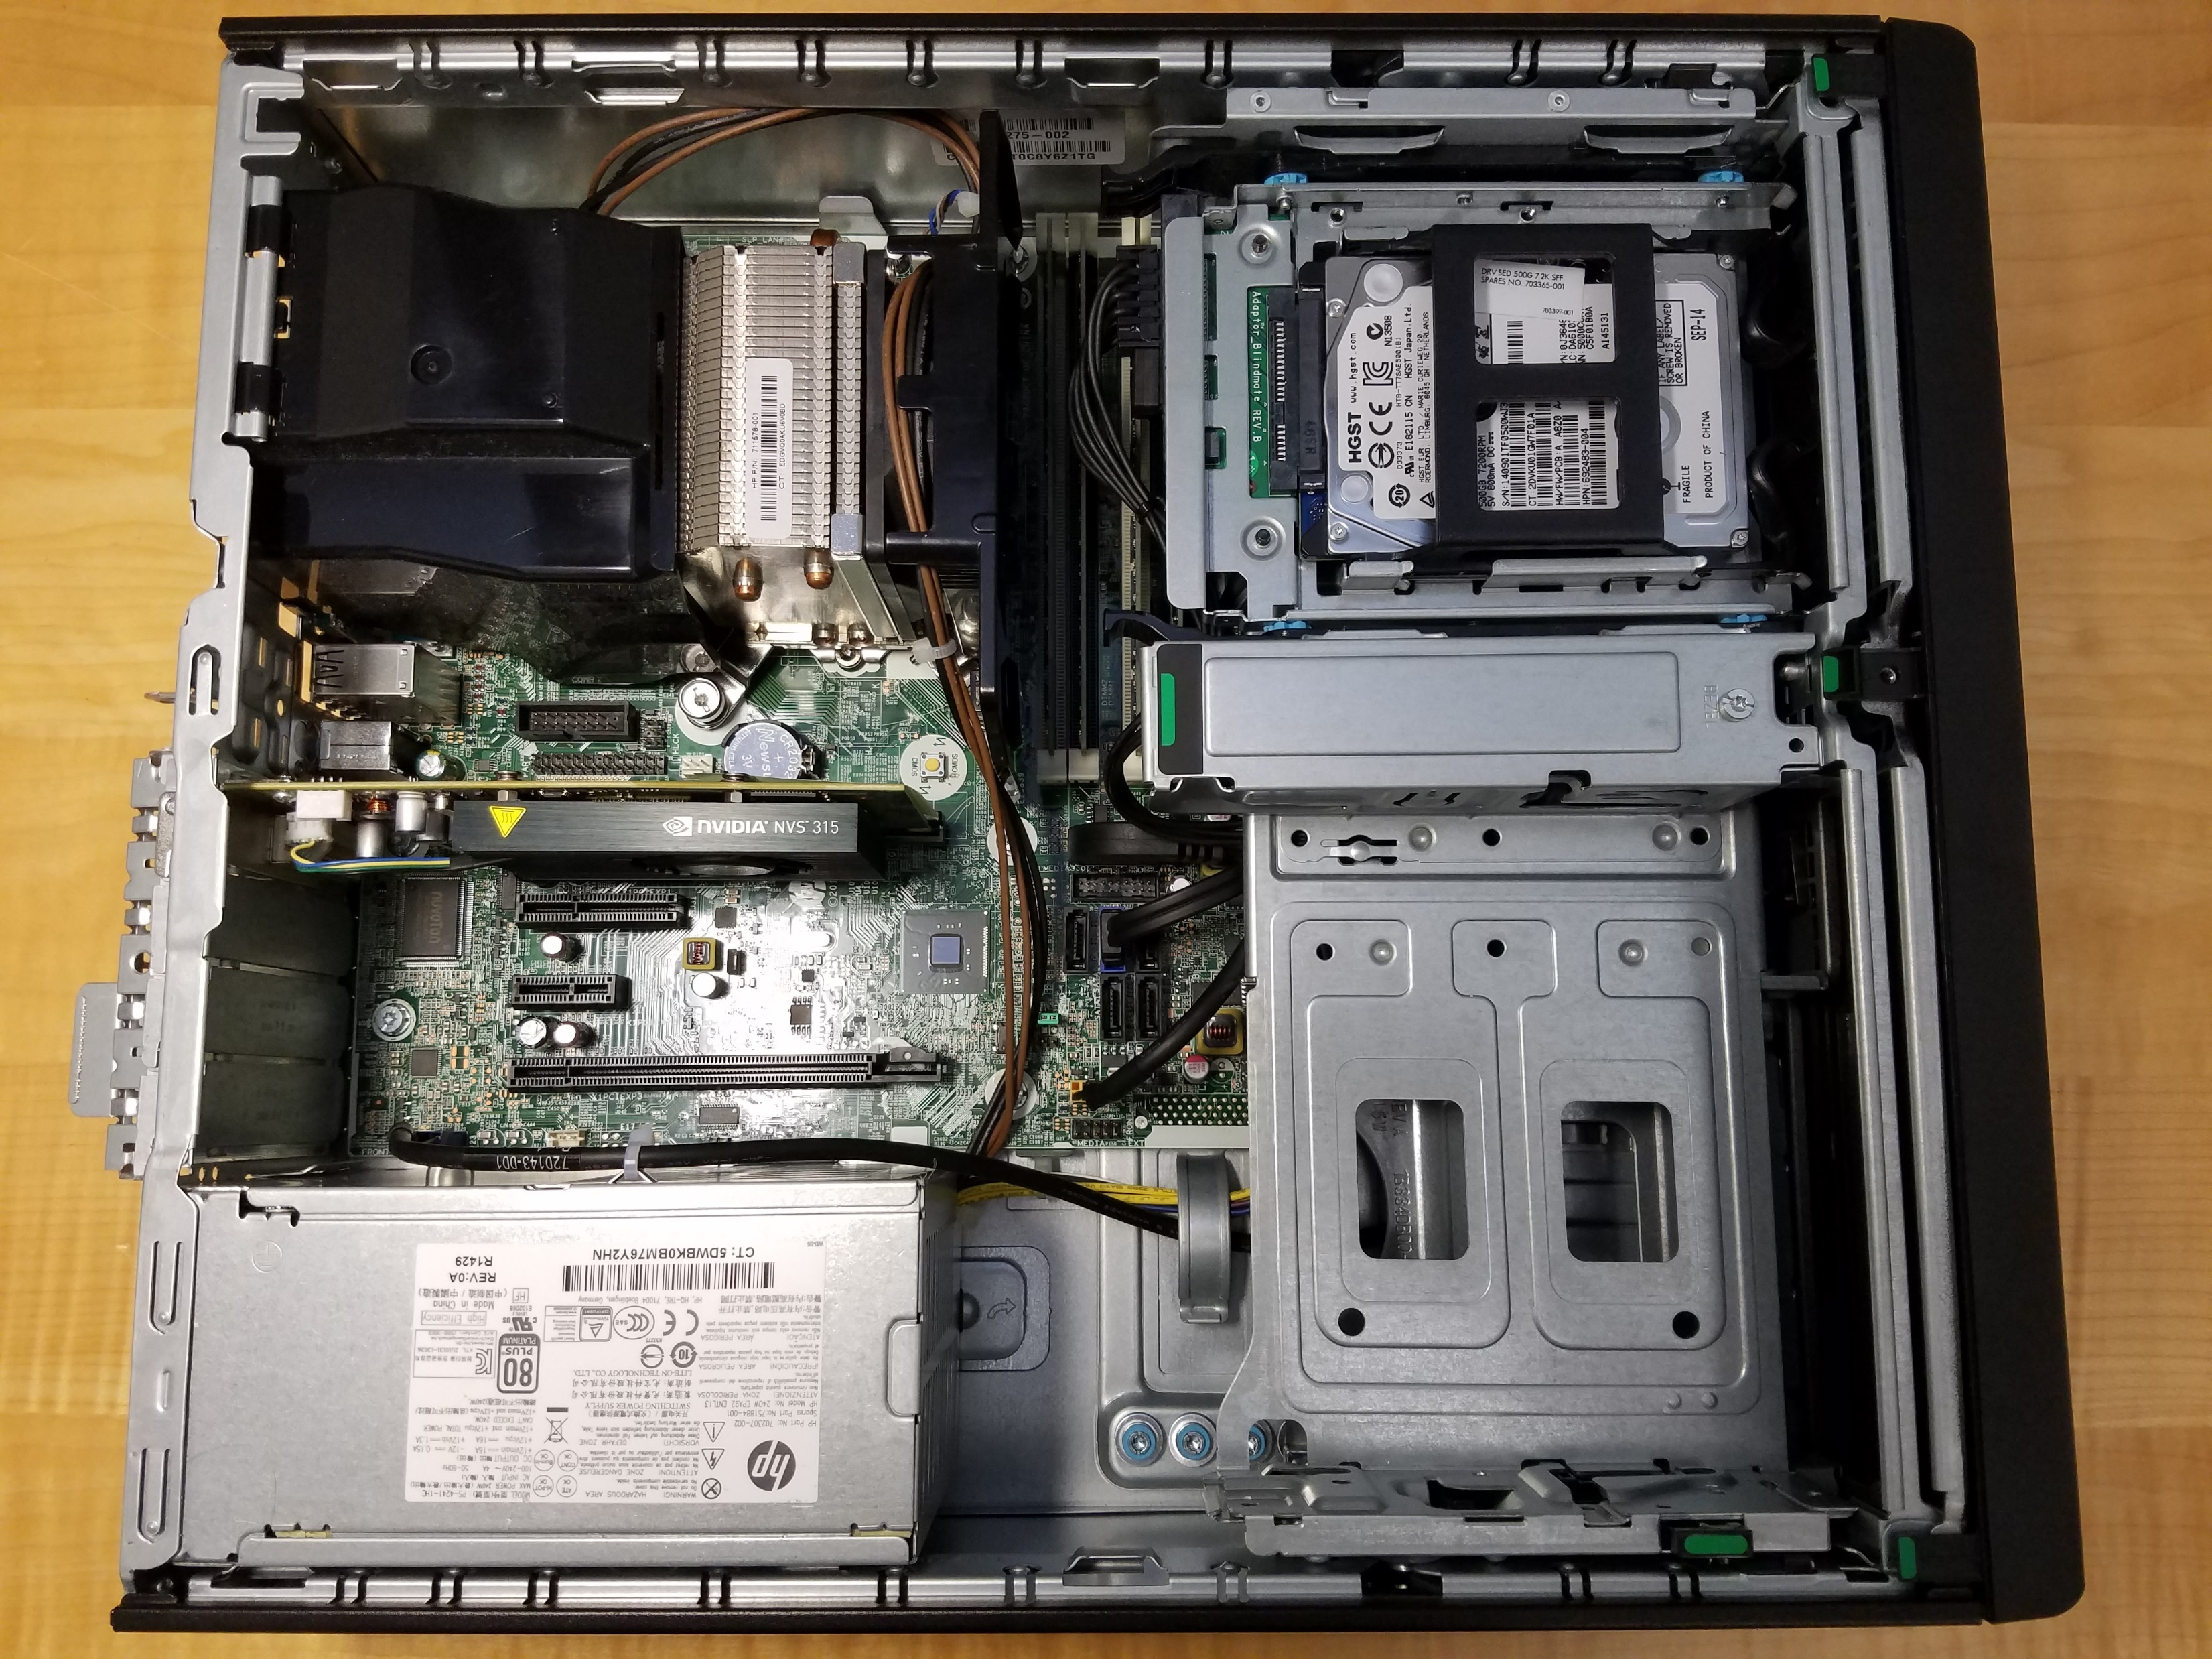
Airflow in HP Z230
CPU Fan
PSU Fan

Slide 30
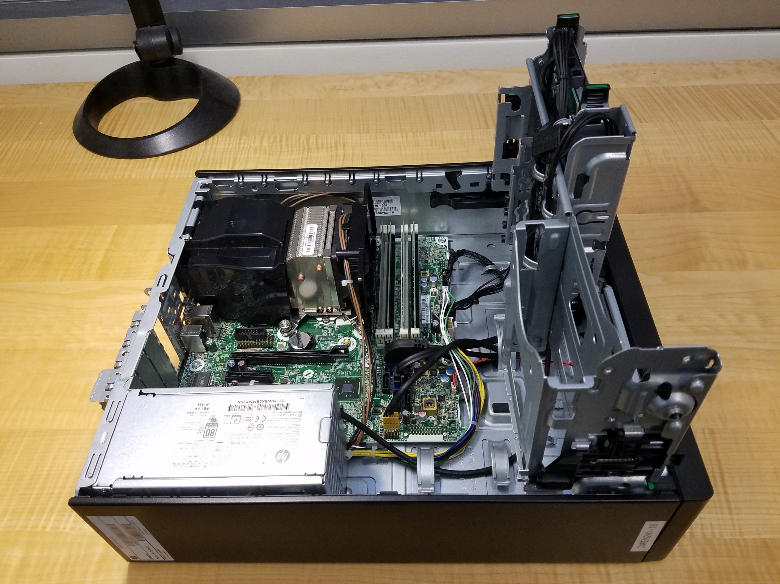
Cases
Extra screws
A good case holds all the components safely, facilitates cooling, and provides for easy maintenance
The HP Z230 is a Small Form Factor (SFF) case
Cards held down by flip clamp instead of screws
Drive cages rotate for ease of removal
Cable management hooks

Slide 31
Conclusion
Computer parts are always changing
New components have a high extra margin of cost on them compared to the previous generation
Identifying different types of components comes with exposure and experience
Check out https://pcpartpicker.com/
It’s awesome

